Slide 1
Alarms and Schedulers
Android Developer Fundamentals V2
Lesson 8

Slide 2
8.2 Alarms

Slide 3
Contents
What are Alarms
Alarms Best Practices
Alarm Manager
Scheduling Alarms
More Alarm Considerations

Slide 4
What Are Alarms

Slide 5
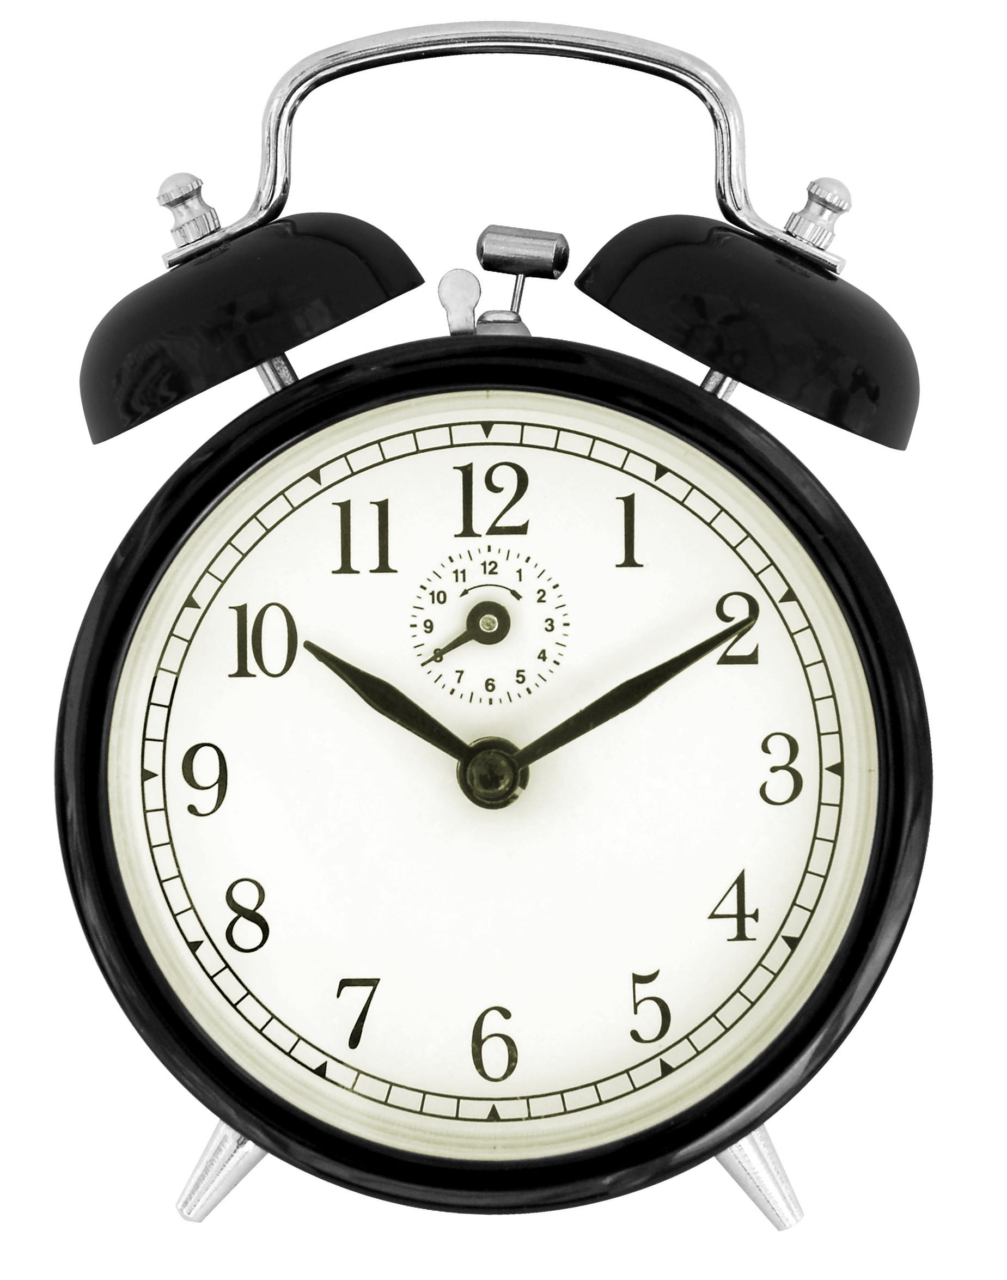
What is an alarm in Android?
Not an actual alarm clock.
Schedules something to happen at a set time.
Fire intents at set times or intervals.
Goes off once or recurring.
Can be based on a real-time clock or elapsed time.
App does not need to run for alarm to be active.

Slide 6
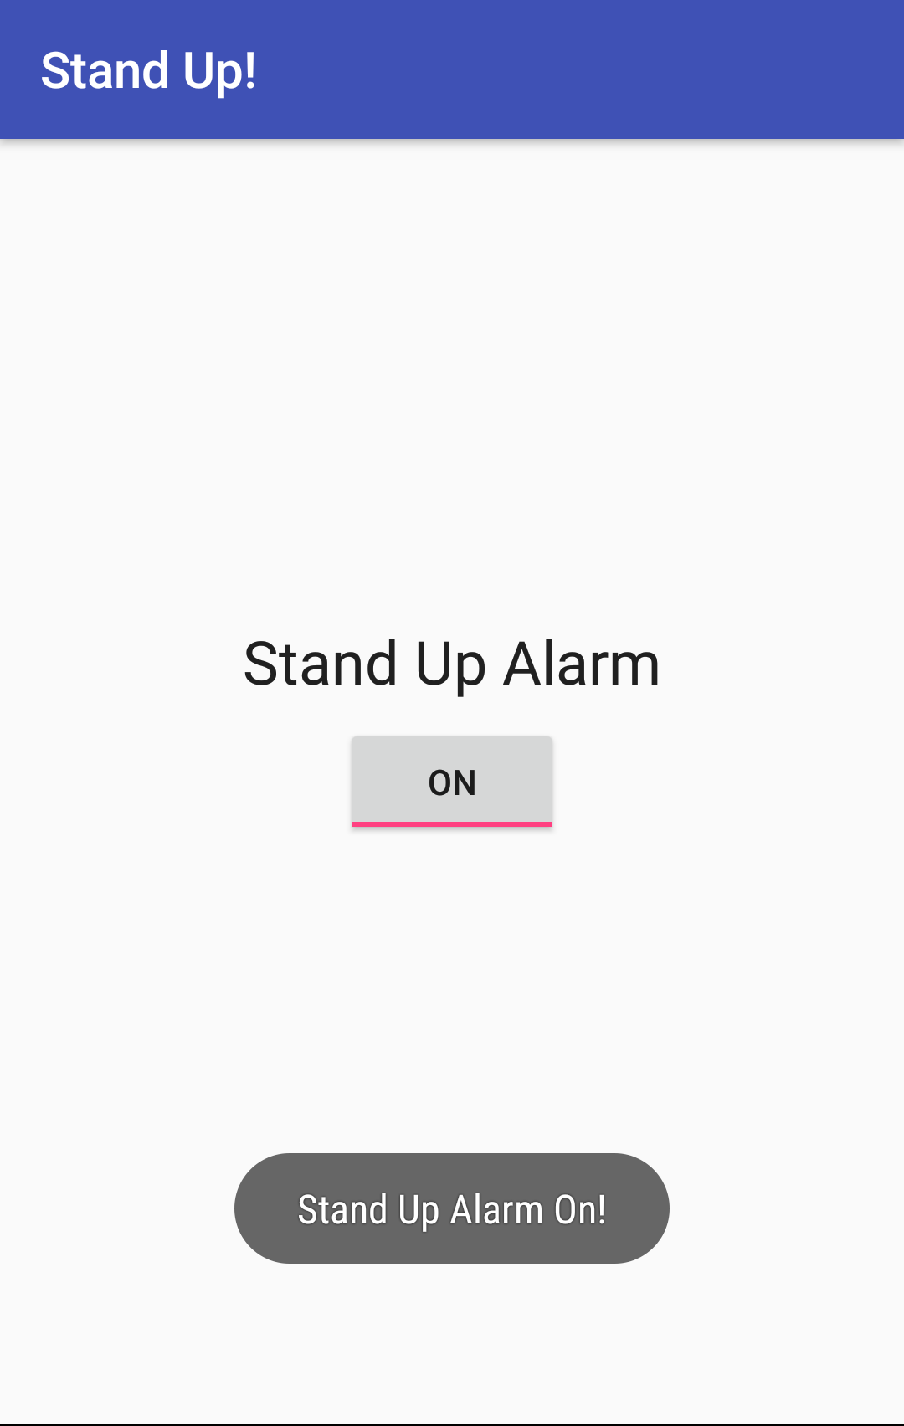
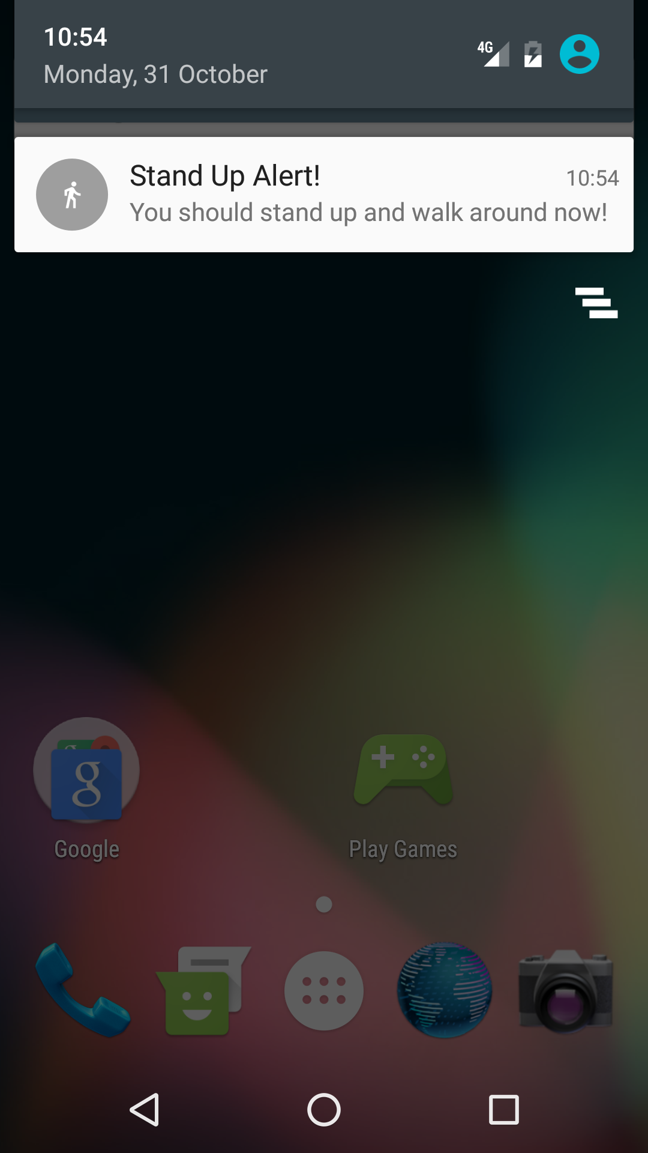
How alarms work with components
BroadcastReceiver
wakes up the app and delivers the notification.
BroadcastReceiver
wakes up
delivers notification
Activity creates a notification and
sets an alarm.
Alarm triggers and sends out Intent.
App may be destroyed so….

Slide 7
Benefits of alarms
App does not need to run for alarm to be active.
Device does not have to be awake.
Does not use resources until it goes off.
Use with BroadcastReceiver to start services and other operations.

Slide 8
Measuring time
Elapsed Real Time—time since system boot.
Independent of time zone and locale.
Use for intervals and relative time.
Use whenever possible.
Elapsed time includes time device was asleep.
Real Time Clock (RTC)—UTC (wall clock) time.
When time of day at locale matter.

Slide 9
Wakeup behavior
Wakes up device CPU if screen is off.
Use only for time critical operations.
Can drain battery.
Does not wake up device.
Fires next time device is awake.
Is polite.

Slide 10
Types of alarms
 | Elapsed Real Time (ERT)—since system boot | Real Time Clock (RTC)—time of day matters
Do not wake up device | ELAPSED_REALTIME | RTC
Wake up | ELAPSED_REALTIME_WAKEUP | RTC_WAKEUP

Slide 11
Alarms Best Practices

Slide 12
If everybody syncs at the same time...
Imagine an app with millions of users:
Server sync operation based on clock time.
Every instance of app syncs at 11:00 p.m.
Load on the server could result in high latency or even "denial of service"

Slide 13
Alarm Best Practices
Add randomness to network requests on alarms.
Minimize alarm frequency.
Use ELAPSED_REALTIME, not clock time, if you can.

Slide 14
Battery
Minimize waking up the device.
Use inexact alarms.
Android synchronizes multiple inexact repeating alarms and fires them at the same time.
Reduces the drain on the battery.
Use setInexactRepeating() instead of setRepeating().

Slide 15
When not to use an alarm
Ticks, timeouts, and while app is running—Handler.
Server sync—SyncAdapter with Cloud Messaging Service.
Inexact time and resource efficiency—JobScheduler.

Slide 16
AlarmManager

Slide 17
What is AlarmManager
AlarmManager provides access to system alarm services.
Schedules future operation.
When alarm goes off, registered Intent is broadcast.
Alarms are retained while device is asleep.
Firing alarms can wake device.

Slide 18
Get an AlarmManager
AlarmManager alarmManager =
(AlarmManager) getSystemService(ALARM_SERVICE);

Slide 19
Scheduling Alarms

Slide 20
What you need to to schedule an alarm
Type of alarm.
Time to trigger.
Interval for repeating alarms.
PendingIntent to deliver at the specified time (just like notifications).

Slide 21
Schedule a single alarm
set()—single, inexact alarm.
setWindow()—single inexact alarm in window of time.
setExact()—single exact alarm.
More power saving options AlarmManager API 23+.

Slide 22
Schedule a repeating alarm
setInexactRepeating()
repeating, inexact alarm.
setRepeating()
Prior to API 19, creates a repeating, exact alarm.
After API 19, same as setInexactRepeating().

Slide 23
setInexactRepeating()
setInexactRepeating(
int alarmType,
long triggerAtMillis,
long intervalMillis,
PendingIntent operation)

Slide 24
Create an inexact alarm
alarmManager.setInexactRepeating(
AlarmManager.ELAPSED_REALTIME_WAKEUP,
SystemClock.elapsedRealtime()
+ AlarmManager.INTERVAL_FIFTEEN_MINUTES,
AlarmManager.INTERVAL_FIFTEEN_MINUTES,
notifyPendingIntent);

Slide 25
More Alarm Considerations

Slide 26
Checking for an existing alarm
boolean alarmExists =
(PendingIntent.getBroadcast(this,
0, notifyIntent,
PendingIntent.FLAG_NO_CREATE) != null);

Slide 27
Doze and Standby
Doze—completely stationary, unplugged, and idle device.
Standby—unplugged device on idle apps.
Alarms will not fire.
API 23+.

Slide 28
User visible alarms
setAlarmClock()
System UI may display time/icon.
Precise.
Works when device is idle.
App can retrieve next alarm with getNextAlarmClock().
API 21+.

Slide 29
Cancel an alarm
Call cancel() on the AlarmManager
pass in the PendingIntent.
alarmManager.cancel(alarmPendingIntent);

Slide 30
Alarms and Reboots
Alarms are cleared when device is off or rebooted.
Use a BroadcastReceiver registered for the BOOT_COMPLETED event and set the alarm in the onReceive() method.

Slide 31
Learn more
Schedule Repeating Alarms Guide
AlarmManager reference
Choosing an Alarm Blog Post
Scheduling Alarms Presentation
Optimizing for Doze and Standby

Slide 32
What's Next?
Concept Chapter: 8.2 Alarms
Practical: 8.2 The Alarm Manager

Slide 33
END

